Slide 1
Coursera Capstone IBM Data Science Capstone Recommended Location for Starting an OFFICE IN BARCELONA BY OLGA GARCIA 22-JAN-2021

Slide 2
BUSINESS PROBLEM
With the pandemic, many companies are interested in to improve their office location due to the possible need or request to telework on the part of their workers.
Some companies want to relocate its offices improving both the experience of its customers and their loyalty, as well as promoting the majority of workers to attend the office.

Slide 3
METHODOLOGY
Web Scraping Wikipedia to get the neighborhood list in Barcelona.
Get Latitude and Longitude using Geo Coder
Use FourSquare API to get the restaurants
The data has been visualized using folium package to see the number of restaurants near Plaza Urquinaona and Sagrada Familia
The data extracted from the FourSquare API will be arranged as a dataframe for visualization and to analyze

Slide 4
Results
Plaza Urquinaona (Barcelona).
We found 28 restaurants. The nearest was Piú Restaurant, which was 332 meters from the specific zone. It doesn't have a rating but it has a very good review. The restaurant is located in a place near to the best shopping places of the city.
Sagrada Familia (Barcelona)
We found 27 restaurants. The nearest was Subway, which was 119 meters from the specific zone but it doesn't have any rating or tip. The next one is Bar Restaurant Sagrada Familia, a bit far, 350 meters. It has a rating of 6.4 and 4 tips. With this rating we didn't analyze the tips. This restaurant is not located ina a place with a lot of shopping places.

Slide 5
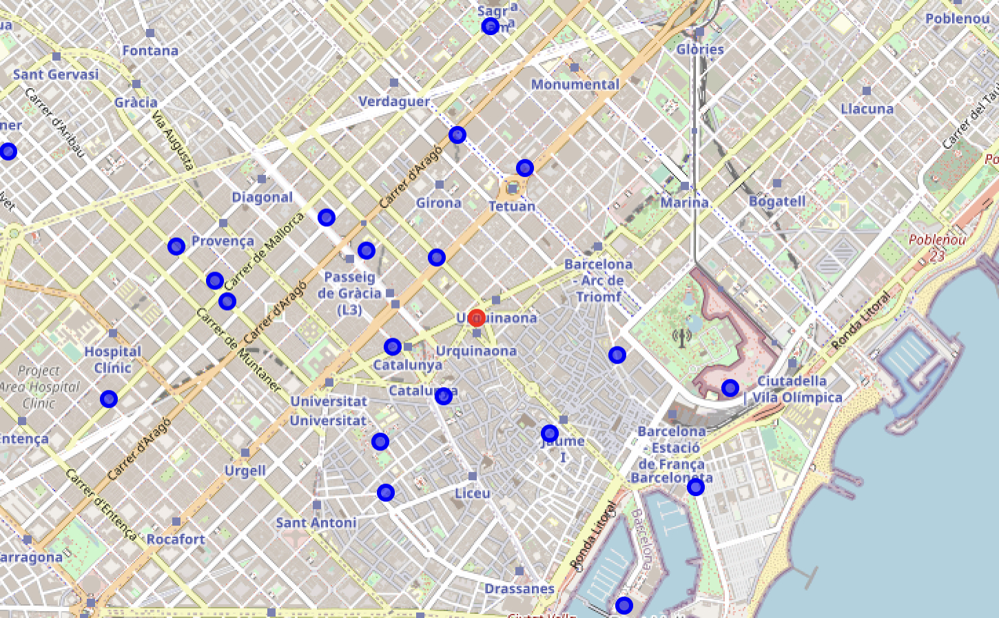
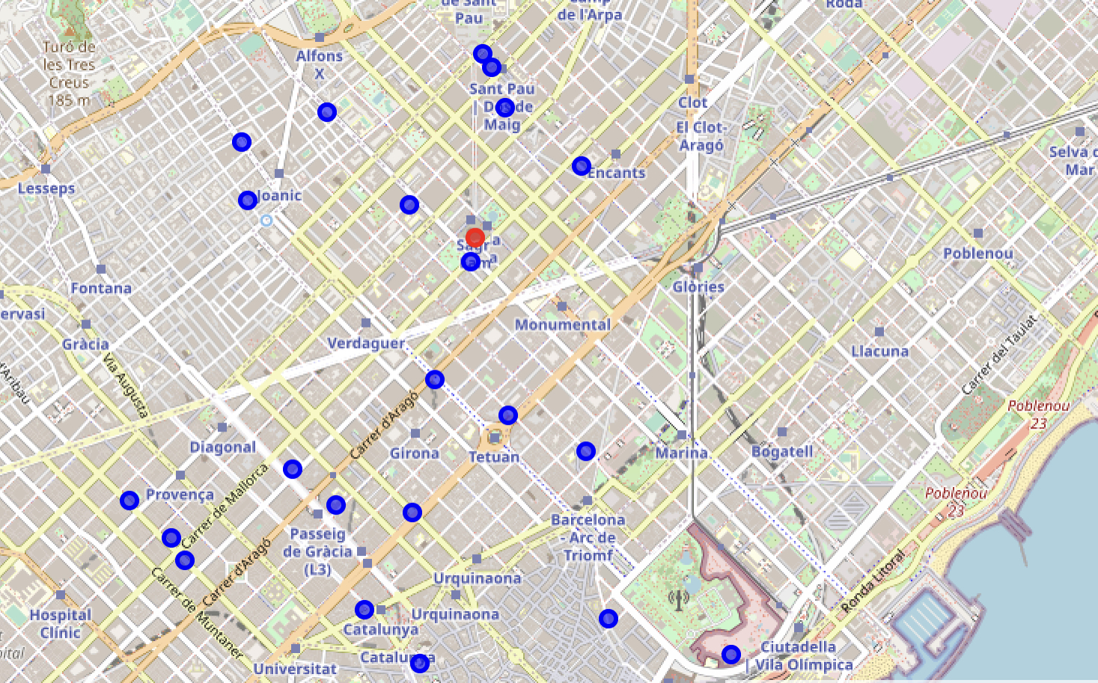
Results
Plaza Urquinaona (Barcelona)
Sagrada Familia (Barcelona)

Slide 6
Discussion
Based on the client's requirements to find a place with restaurants nearby, that the closest restaurant is well valued, near shopping areas and the analysis presented above, we will recommend Plaza Urquinaona to our client. We hope that the greater concentration of coffee shops in Plaza Urquinaona, as well as the availability of quality coffee shops and the proximity to the best shopping areas in the city, will provide our customers with a good selection and variety.

Slide 7
Conclusion
By applying the principles of data science we have been able to compare two locations and visualize the distribution of restaurants in the area. We hope this sets our product apart from the competition and helps us personalize experiences when making strategic business decisions for our customers.

